Slide 1
Dataset for Camera Algorithm

Slide 2
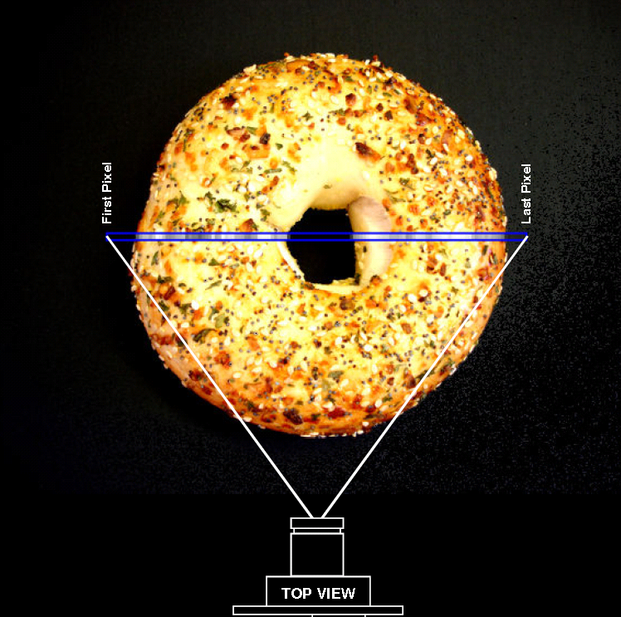
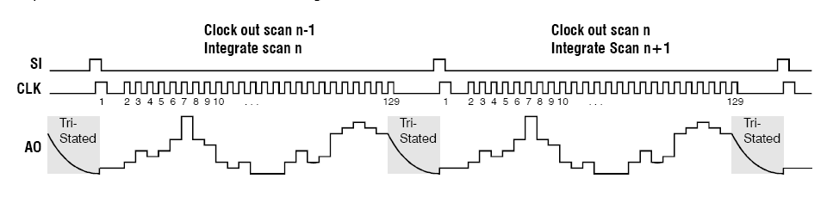
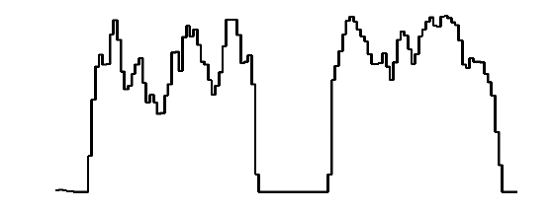
Linescan Imaging Sensor
1x128 pixels
0-5 volts output for each pixel
One pixel returned for each clock pulse

Slide 3
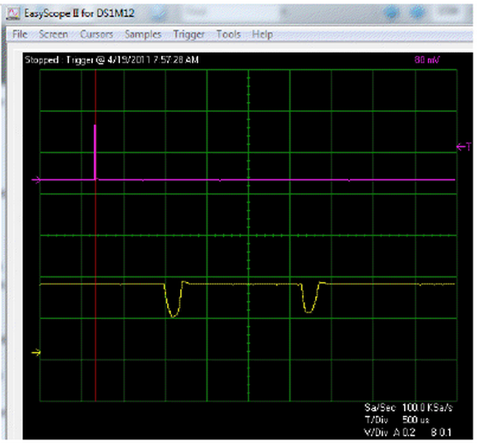
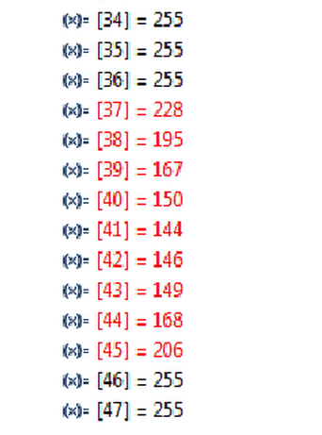
Actual Data From Camera April 19^{th –}
Data Registers Showing Line Intensity Scan
Camera is showing two lines

Slide 4
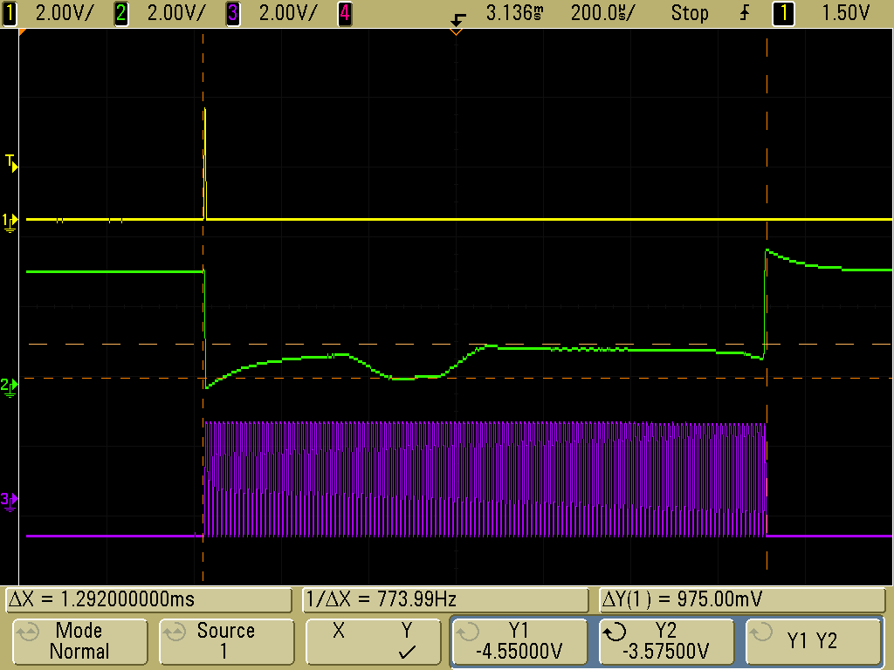
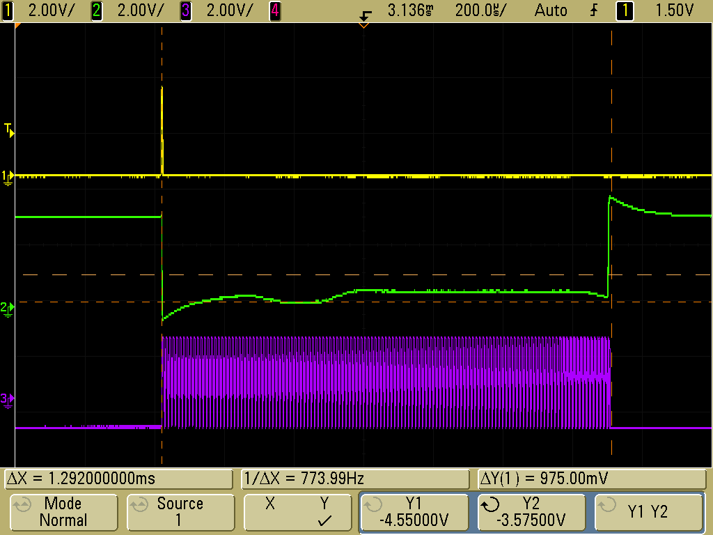
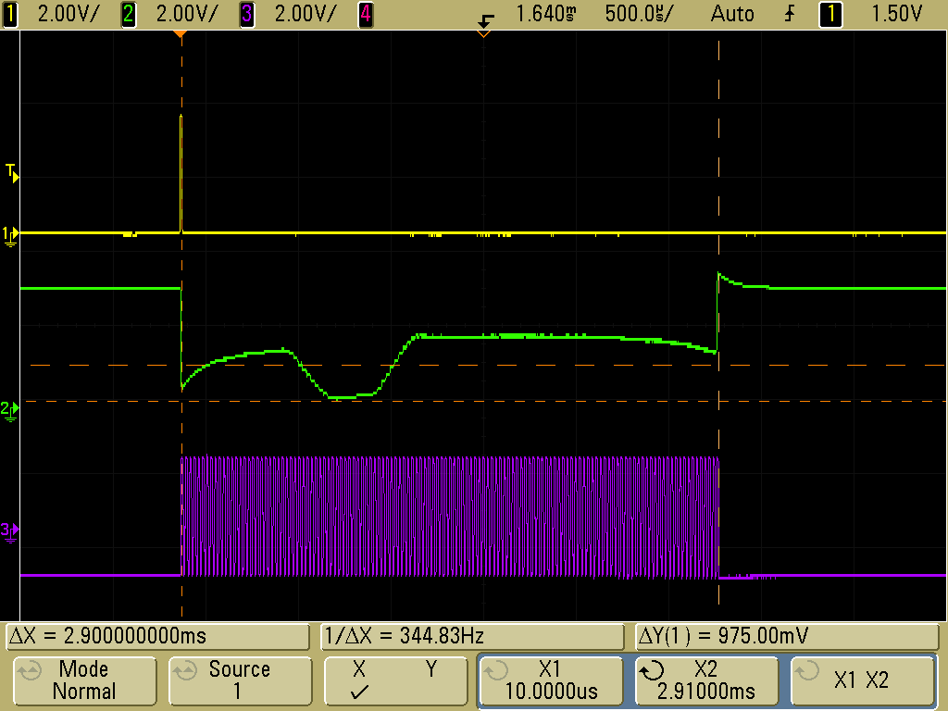
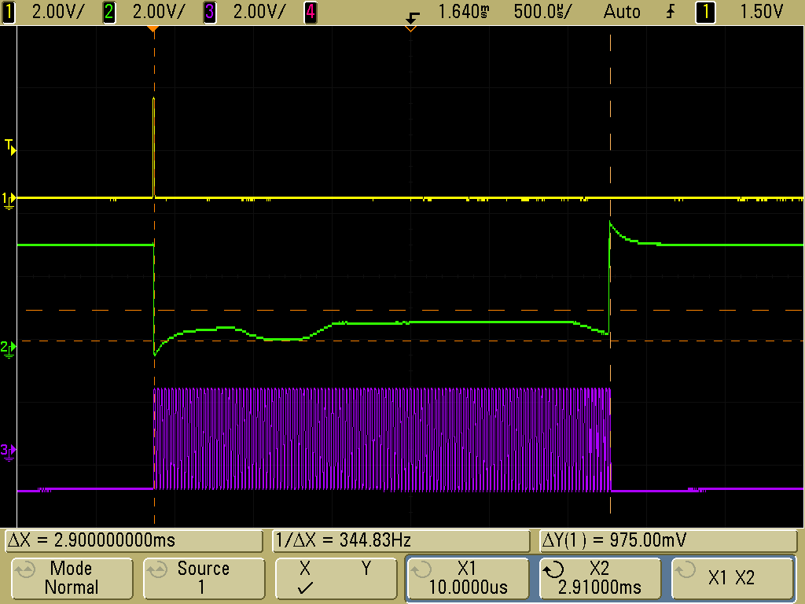
Yellow – start capture, green – camera feed, purple - pulse to obtain 128x1 data
With TAUS_Exposure_Delay(25); 1.2 ms / cycle
Under bright light conditions
No Light
With TAUS_Exposure_Delay(75); 2.9ms to run full cycle
Under bright light conditions
No Light

Slide 5
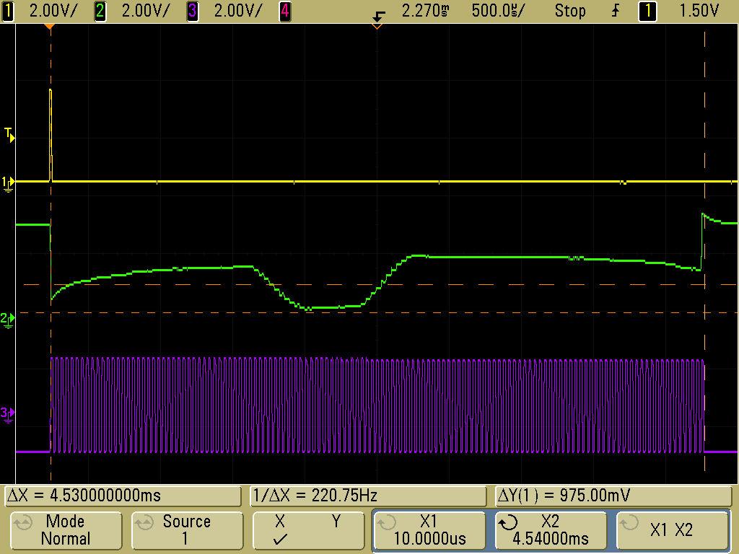
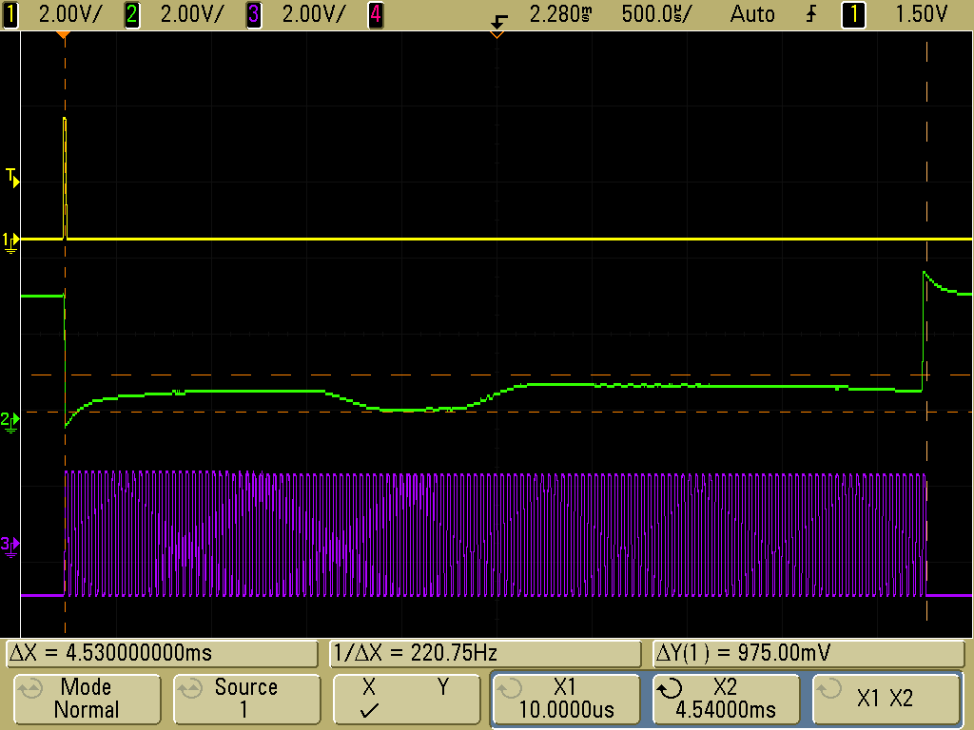
With TAUS_Exposure_Delay(125); 4.5ms to run full cycle
Under bright light conditions
No Light

